Slide 1
UVM TLM Introduction
Chen-Hsiung Liu
2024/10/27

Slide 2
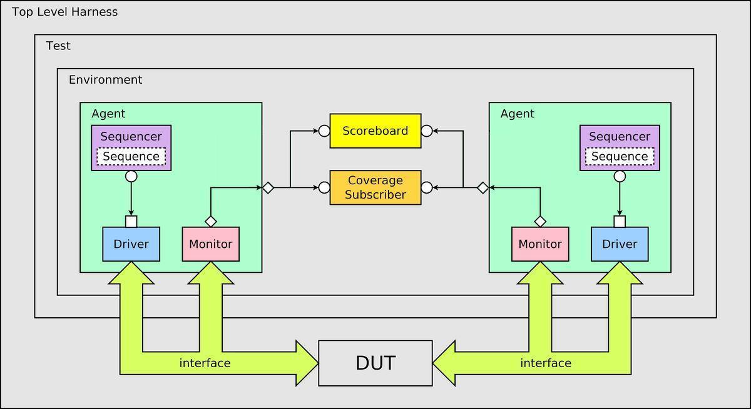
UVM Testbench Architecture
Notes:
https://csbearnokiseki.blogspot.com/2017/06/uvm.html

Slide 3
Communication in UVM: TLM 1.0, 2.0
TLM Classes – 1.0
uvm_*_port
uvm_*_export
uvm_*_imp
uvm_*_fifo
TLM Classes – 2.0
uvm_*_socket
env
sequencer
sequence
driver

Slide 4
UVM TLM 1.0
Push
Pull
Fifo
Analysis (broadcast)
put_producer calls port.put()
put_consumer implements put()
pull_consumer implements pull()
pull_producer calls port.pull()
producer calls port.put()
FIFO
consumer calls port.pull()
write_producer calls port.write()
write_subscriber implements write()
write_subscriber implements write()
write_subscriber implements write()

Slide 5
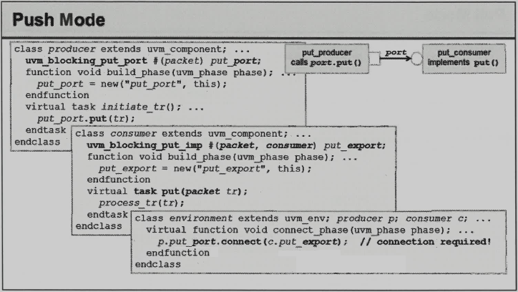

Slide 6
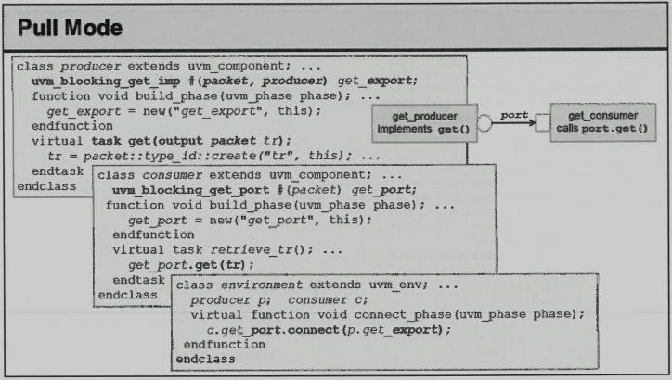

Slide 7
TLM Port methods
virtual function bit can_*()
Returns 1 if a new transaction is available; 0 otherwise.
Class \ Method | put | try_ put | can_ put | get | try_ get | can_ get | peek | try_ peek | can_ peek | write
uvm_blocking_ put_port | X
uvm_nonblocking_ put_port |  | X | X
uvm_put_port | X | X | X
uvm_blocking_ get_port |  |  |  | X
uvm_nonblocking_ get_port |  |  |  |  | X | X
uvm_get_port |  |  |  | X | X | X
uvm_blocking_ peek_port |  |  |  |  |  |  | X
uvm_nonblocking_ peek_port |  |  |  |  |  |  |  | X | X
uvm_peek_port |  |  |  |  |  |  | X | X | X
uvm_blocking_ get_peek_port |  |  |  | X |  |  | X
uvm_nonblocking_ get_peek_port |  |  |  |  | X | X |  | X | X
uvm_get_peek_port |  |  |  | X | X | X | X | X | X
uvm_blocking_ master_port | X |  |  | X |  |  | X
uvm_nonblocking_ master_port |  | X | X |  | X | X |  | X | X
uvm_master_port | X | X | X | X | X | X | X | X | X
uvm_blocking_ slave_port | X |  |  | X |  |  | X
uvm_nonblocking_ slave_port |  | X | X |  | X | X |  | X | X
uvm_slave_port | X | X | X | X | X | X | X | X | X
uvm_analysis_port |  |  |  |  |  |  |  |  |  | X

Slide 8
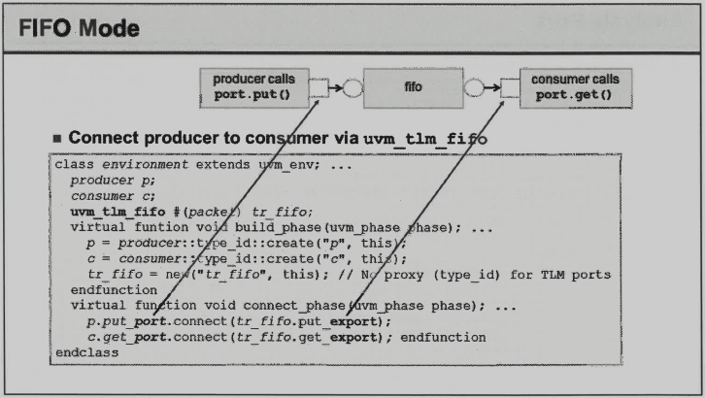



Slide 9
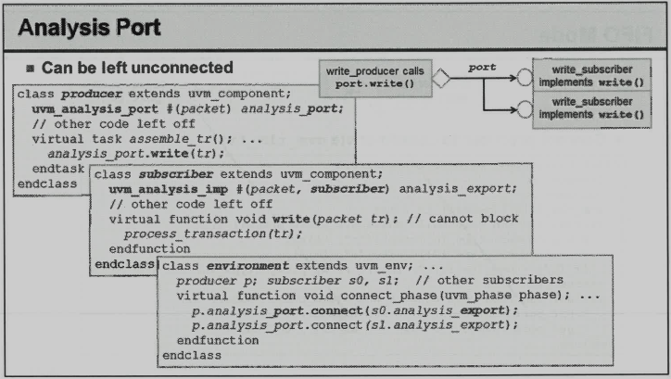

Slide 10
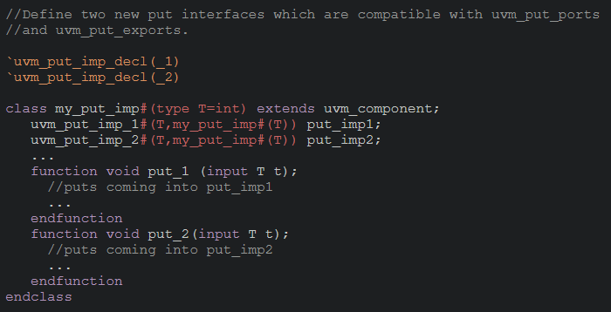
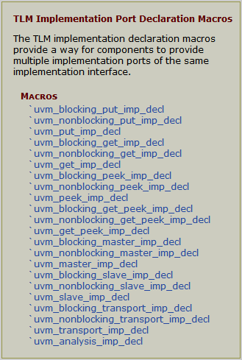
TLM Imp Port Declaration Macros (1)

Slide 11
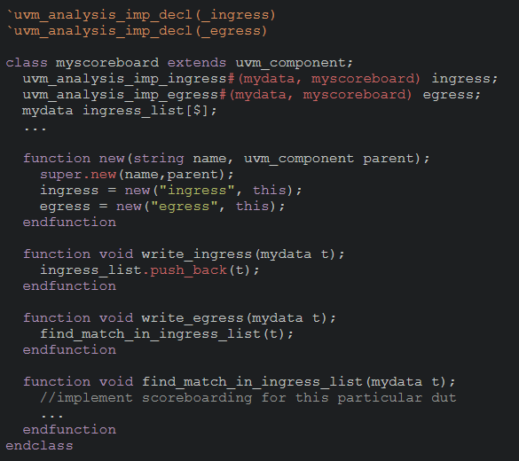
TLM Imp Port Declaration Macros (2)

Slide 12
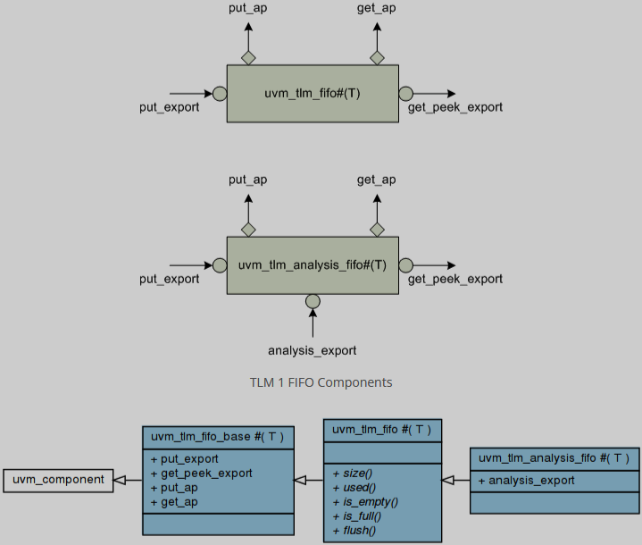
UVM TLM FIFO
default size = 1
default size = 0, unbounded
(uvm_analysis_imp)

Slide 13
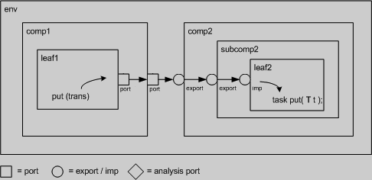
TLM connect
Hierarchical port connections are resolved and optimized just before uvm_component::end_of_elaboration_phase. After optimization, calling any port’s interface method (e.g. leaf1.out.put(trans)) incurs a single hop to get to the implementation (e.g. leaf2’s put task), no matter how far up and down the hierarchy the implementation resides.
port-to-port | leaf1’s out port is connected to its parent’s (comp1) out port
port-to-export | comp1’s out port is connected to comp2’s in export
export-to-export | comp2’s in export is connected to its child’s (subcomp2) in export
export-to-imp | subcomp2’s in export is connected leaf2’s in imp port.
imp-to-implementation | leaf2’s in imp port is connected to its implementation, leaf2

Slide 14
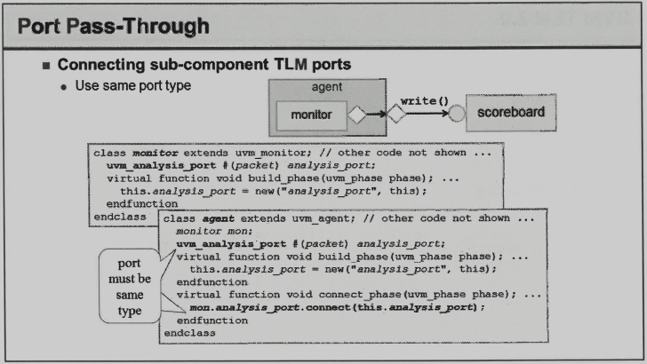

Slide 15
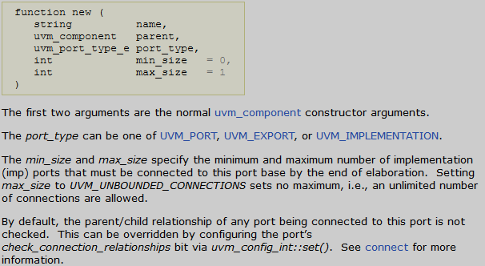
Port Base Class
uvm_port_base #(IF)
The debug_connected_to method outputs a visual text display of the port/export/imp network to which this port connects (i.e., the port’s fanout).
The debug_provided_to method outputs a visual display of the port/export network that ultimately connect to this port (i.e., the port’s fanin).

Slide 16
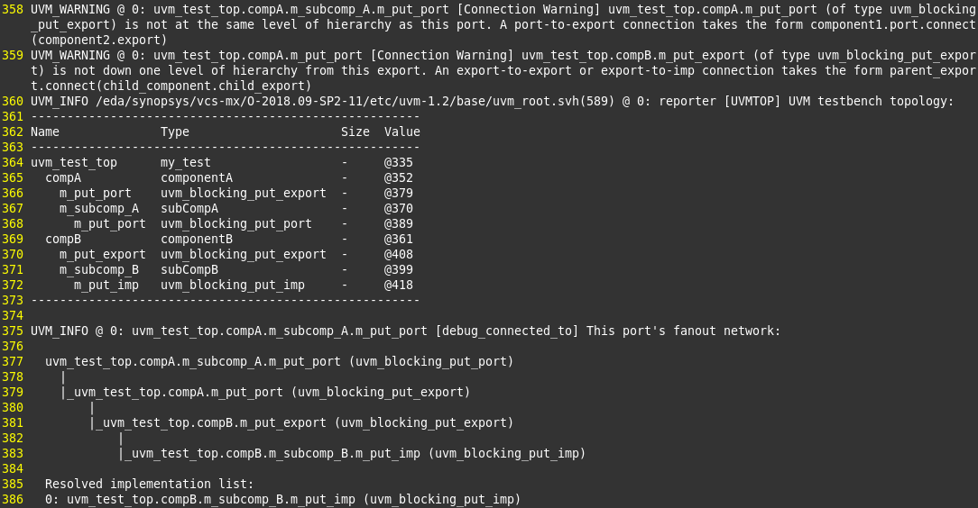
Check and Debug Connection

Slide 17
UVM built-in check
Size check uses size() to get the number of implementation ports connected to this port.
`UVM_PORT_COMMON, `UVM_EXPORT_COMMON, `UVM_IMP_COMMON, default min_size=1, max_size=1.
uvm_analysis_port, default min_size=0, max_size=unbounded.
uvm_analysis_export, default min_size=1, max_size=unbounded.
uvm_analysis_imp, default min_size=1, max_size=1.
Error message example:
[Connection Error] connection count of 0 does not meet required minimum of 1
[Connection Error] connection count of 2 exceeds maximum of 1

Slide 18
TLM Connection Example (1)
This is legal.
env
compA1
compB1
subcompA
subcompB
compA2
compB2
subcompA
subcompB

Slide 19
TLM Connection Example (2)
This is legal.
env
compA1
compB1
subcompA
subcompB
compA2
compB2
subcompA
subcompB

Slide 20
TLM Connection Example (3)
This is illegal.
env
compA1
compB1
subcompA
subcompB
compA2
compB2
subcompA
subcompB

Slide 21
TLM Connection Example (4)
This is legal. (not recommended)
env
agent
scoreboard
uvm_tlm_analysis_fifo
get()
analysis_export
monitor

Slide 22
UVM TLM 2.0
Blocking
Non-blocking
b_transport (tx, delay)
initiator
target
nb_transport_fw (tx, p, delay)
initiator
target
nb_transport_bw (tx, p, delay)

Slide 23
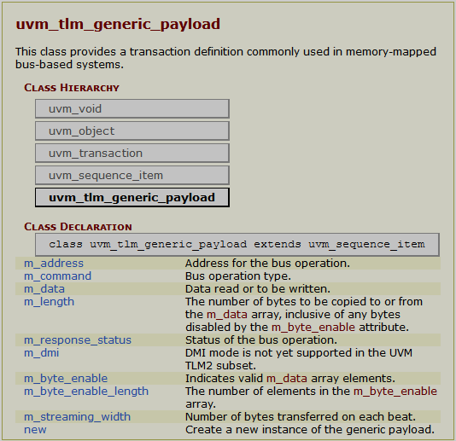
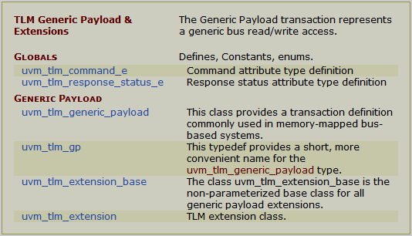
TLM 2.0 Generic Payload

